Slide 1

A review on -
Sentence Similarity

Slide 2

Sentence Similarity
Lexical Similarity
Semantic Similarity
Example:
How are you?
How old are you?
Example:
How old are you?
What is your age?
How to measure this similarity?
Jaccard’s Method: Find the % of common words.
How to measure this similarity?
OUR TODAY’S SESSION!
$$Jaccard Coeff=\frac{No. ofcommon words}{Total number of words}=\frac{3}{4}=75\% similar$$
A very bad measure of similarity!

Slide 3
Semantic Similarity
Corpus-based Techniques
Knowledge-based Techniques
Example:
WordNet’s Wu-Palmer Similarity
Leacock Chodorow Similarity
Statistical Methods
Deep-Learning Methods
Example:
LSA(LSI)
Example:
Continuous Bag of Words
The Skip-gram model
Siamese-Manhattan LSTM
BERT embeddings

Slide 4
1. Latent Semantic Analysis (LSA)
Corpus:
Human machine interface for computer applications
User opinion of computer system response time
User interface management system
System engineering for improved response time
Vocabulary, V = [human, machine, interface, for, computer, application, user, opinion, of, system,
response, time, engineering, improved, management]
One-hot representation of words in vocabulary:
Human = [1, 0, 0, …, 0, 0, 0]
Not a good representation! We wish our words to carry context information as well.

Slide 5
1. Latent Semantic Analysis (LSA)
Corpus:
Human machine interface for computer applications
User opinion of computer system response time
User interface management system
System engineering for improved response time
 | Human | Machine | System | For | … | User
Human | 0 | 1 | 0 | 1 | … | 0
Machine | 1 | 0 | 0 | 1 | … | 0
System | 0 | 0 | 0 | 1 | … | 2
For | 1 | 1 | 1 | 0 | … | 0
… | … | … | … | … | … | …
User | 0 | 0 | 2 | 0 | … | 0
Co-occurrence matrix capturing context of every word in the vocabulary from the corpus, in a window of k = 2 words.

Slide 6
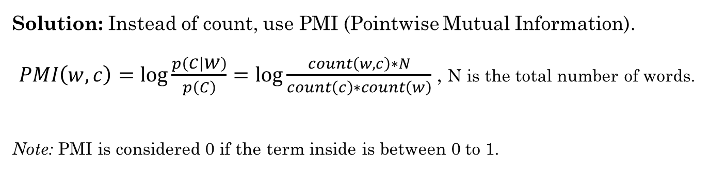
1. Latent Semantic Analysis (LSA)
 | Human | Machine | System | For | … | User
Human | 0 | 1 | 0 | 1 | … | 0
Machine | 1 | 0 | 0 | 1 | … | 0
System | 0 | 0 | 0 | 1 | … | 2
For | 1 | 1 | 1 | 0 | … | 0
… | … | … | … | … | … | …
User | 0 | 0 | 2 | 0 | … | 0
Problems:
Stop words occur very often and they hardly carry any contextual meaning.
Some frequent words carry a lot of weightage, which should be avoided.
Solution: Instead of count, use PMI (Pointwise Mutual Information).
$PMI\left(w, c\right)=\log{\frac{p\left(c | w\right)}{p\left(C\right)}=\log{\frac{count\left(w, c\right)∗N}{count\left(c\right)∗count\left(w\right)}}}$ , N is the total number of words.
Note: PMI is considered 0 if the term inside is between 0 to 1.

Slide 7
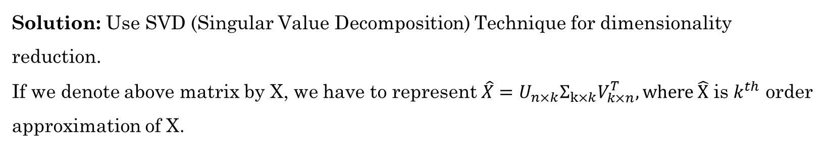
1. Latent Semantic Analysis (LSA)
 | Human | Machine | System | For | … | User
Human | 0 | 2.944 | 0 | 2.25 | … | 0
Machine | 2.944 | 0 | 0 | 2.25 | … | 0
System | 0 | 0 | 0 | 1.15 | … | 1.84
For | 2.25 | 2.25 | 1.15 | 0 | … | 0
… | … | … | … | … | … | …
User | 0 | 0 | 1.84 | 0 | … | 0
Problems:
High dimensionality and very sparse matrix
Does not actually capture contexts correctly
Solution: Use SVD (Singular Value Decomposition) Technique for dimensionality reduction.
If we denote above matrix by X, we have to represent $\hat{X}=U_{n×k}Σ_{k×k}V_{k×n}^{T}, where \hat{X}$ is $k^{th}$ order approximation of X.

Slide 8

1. Latent Semantic Analysis (LSA)
 | Human | Machine | System | For | … | User
Human | 0 | 2.944 | 0 | 2.25 | … | 0
Machine | 2.944 | 0 | 0 | 2.25 | … | 0
System | 0 | 0 | 0 | 1.15 | … | 1.84
For | 2.25 | 2.25 | 1.15 | 0 | … | 0
… | … | … | … | … | … | …
User | 0 | 0 | 1.84 | 0 | … | 0
Steps of doing SVD:
For $X,$find $X^{T}X$ and then find its $n$ Eigen values.
Select $k$ biggest absolute values out of them. Select corresponding Eigen vectors and represent it as $V^{T}$.
Find U as $U=XVΣ^{−1}$.
If we execute above steps, for k = 2, we get the transformed matrix as below one.
 | Human | Machine | System | For | … | User
Human | 2.01 | 2.01 | 0.23 | 2.14 | … | 0.43
Machine | 2.01 | 2.01 | 0.23 | 2.14 | … | 0.43
System | 0.23 | 0.23 | 1.17 | 0.96 | … | 1.29
For | 2.14 | 2.14 | 0.96 | 1.87 | … | -0.13
… | … | … | … | … | … | …
User | 0.43 | 0.43 | 1.29 | -0.13 | … | 1.71

Slide 9
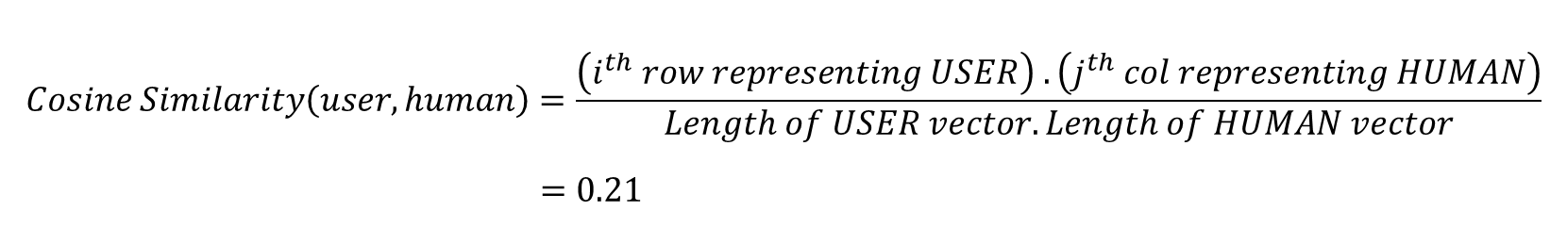
1. Latent Semantic Analysis (LSA)
 | Human | Machine | System | For | … | User
Human | 0 | 2.944 | 0 | 2.25 | … | 0
Machine | 2.944 | 0 | 0 | 2.25 | … | 0
System | 0 | 0 | 0 | 1.15 | … | 1.84
For | 2.25 | 2.25 | 1.15 | 0 | … | 0
… | … | … | … | … | … | …
User | 0 | 0 | 1.84 | 0 | … | 0
This is our original cooccurrence matrix, X.
$$Cosine Similarity\left(user, human\right)=\frac{\left(i^{th} row representing USER\right) .\left(j^{th} col representing HUMAN\right)}{Length of USER vector. Length of HUMAN vector}$$
$$=0.21$$

Slide 10

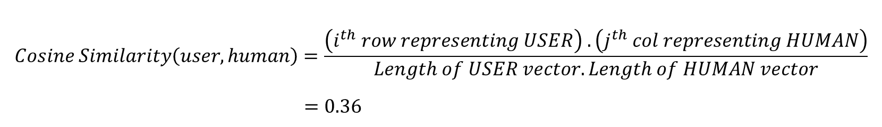
1. Latent Semantic Analysis (LSA)
 | Human | Machine | System | For | … | User
Human | 2.01 | 2.01 | 0.23 | 2.14 | … | 0.43
Machine | 2.01 | 2.01 | 0.23 | 2.14 | … | 0.43
System | 0.23 | 0.23 | 1.17 | 0.96 | … | 1.29
For | 2.14 | 2.14 | 0.96 | 1.87 | … | -0.13
… | … | … | … | … | … | …
User | 0.43 | 0.43 | 1.29 | -0.13 | … | 1.71
This is our SVD matrix, $\hat{X}$.
$$Cosine Similarity\left(user, human\right)=\frac{\left(i^{th} row representing USER\right) .\left(j^{th} col representing HUMAN\right)}{Length of USER vector. Length of HUMAN vector}$$
$$=0.36$$

Slide 11

1. Latent Semantic Analysis (LSA)
Problem: Working with $\hat{X}$ matrix is tough because of its high dimensionality.
Solution: Consider a matrix $W_{words}=UΣ.$
$$\hat{X}{\hat{X}}^{T}=\left(UΣV^{T}\right){\left(UΣV^{T}\right)}^{T}$$
$$=\left(UΣV^{T}\right)\left(VΣU^{T}\right)$$
$$=UΣΣ^{T}U^{T} \left(∵V^{T}V=I\right)$$
$=UΣ{\left(UΣ\right)}^{T}$
$=W_{words}W_{words}^{T}$
This means, $W_{words}$matrix, which has a lot lesser values, is equivalent representation of $\hat{X}.$

Slide 12
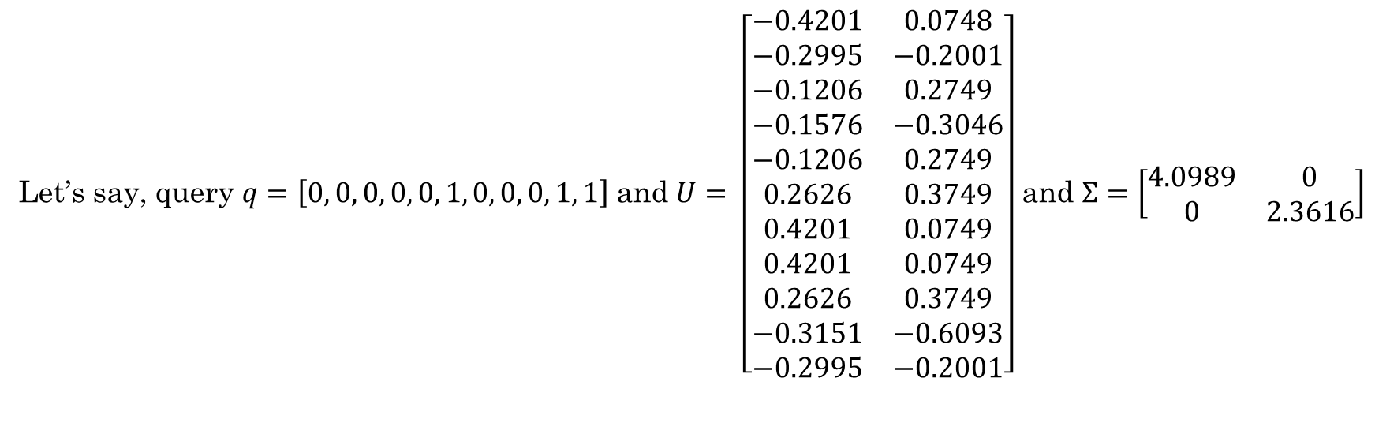
1. Latent Semantic Analysis (LSA)
Problem: How to make a query of similarity?
Solution: Suppose we had 3 sentences initially. For each sentence, represent the vector $u_{i},$ denoting the words in it. Find the representation $d_{i}=u_{i}^{T}UΣ^{−1}.$
Let’s say, query $q=\left[0, 0, 0, 0, 0, 1, 0, 0, 0, 1, 1\right]$and $U= \left[\begin{matrix}−0.4201 & 0.0748 \\ −0.2995 & −0.2001 \\ −0.1206 & 0.2749 \\ −0.1576 & −0.3046 \\ −0.1206 & 0.2749 \\ 0.2626 & 0.3749 \\ 0.4201 & 0.0749 \\ 0.4201 & 0.0749 \\ 0.2626 & 0.3749 \\ −0.3151 & −0.6093 \\ −0.2995 & −0.2001\end{matrix}\right]$ and $Σ=\left[\begin{matrix}4.0989 & 0 \\ 0 & 2.3616\end{matrix}\right]$

Slide 13
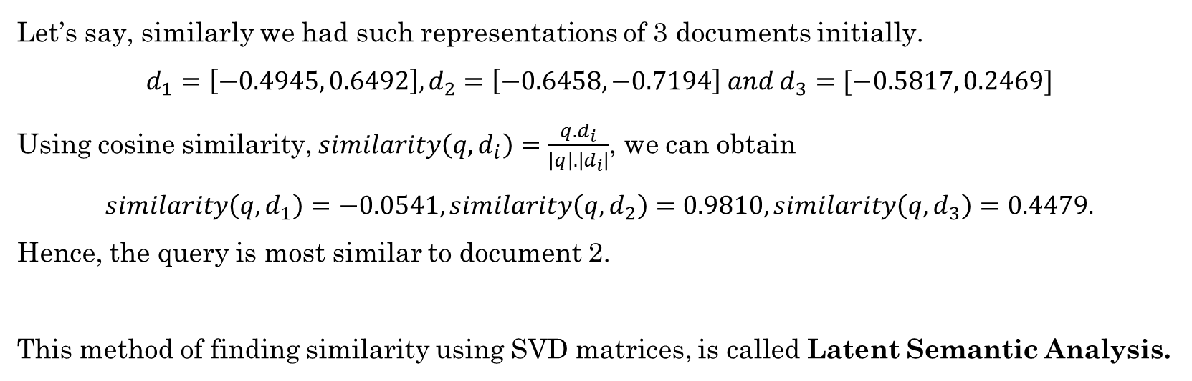
1. Latent Semantic Analysis (LSA)
Problem: How to make a query of similarity?
Solution contd.: Using the formula, $d_{q}=q^{T}UΣ^{−1},$ we get $q=\left[−0.2140, −0.1821\right].$
Let’s say, similarly we had such representations of 3 documents initially.
$$d_{1}=\left[−0.4945, 0.6492\right], d_{2}=\left[−0.6458, −0.7194\right] and d_{3}=[−0.5817, 0.2469]$$
Using cosine similarity, $similarity\left(q, d_{i}\right)=\frac{q.d_{i}}{\left|q\right|.\left|d_{i}\right|}$, we can obtain
$$similarity\left(q, d_{1}\right)=−0.0541,similarity\left(q, d_{2}\right)=0.9810,similarity\left(q, d_{3}\right)=0.4479.$$
Hence, the query is most similar to document 2.
This method of finding similarity using SVD matrices, is called Latent Semantic Analysis.

Slide 14
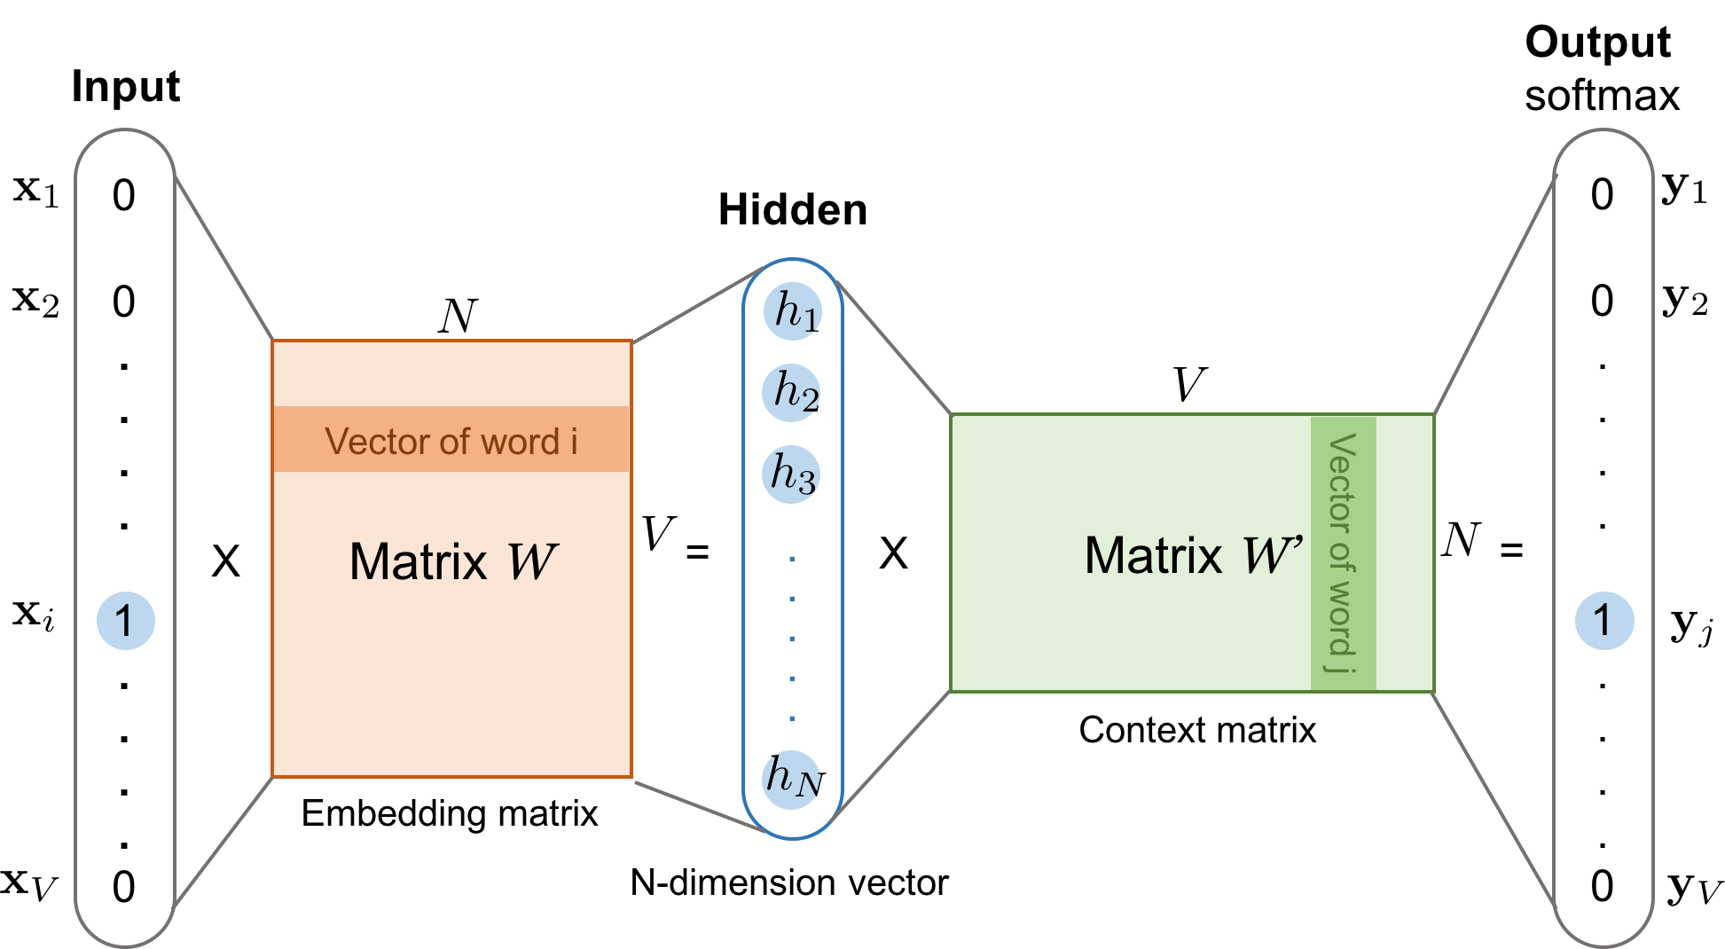
2. The Continuous Bag of Words Model

Slide 15
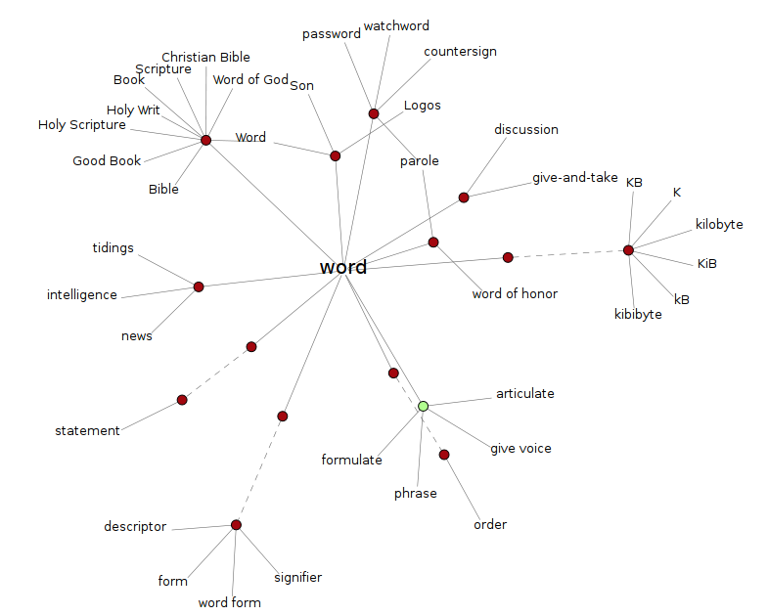
3. Using WordNet Database

Slide 16

3. Using WordNet Database
Wu-Palmer Test
Principle: Given an ontological set (relational graph of similar elements) of element, let the two words which we are querying similarity for, be represented by $s_{1}$ and $s_{2}$, then –
$$WuPalmer Similarity=2∗\frac{depth\left(lcs\left(s_{1}, s_{2}\right)\right)}{depth\left(s_{1}\right)+depth(s_{2})}$$
Note: The value of this ratio is between 0 and 1.

Slide 17
3. Using WordNet Database
Code:
Output:
from nltk.corpus import wordnet as wn
print(wn.synsets('cat', 'n'))
[Synset('cat.n.01'), Synset('guy.n.01’),
Synset('cat.n.03’),
Synset('kat.n.01’),
Synset('cat-o'-nine-tails.n.01'), Synset('caterpillar.n.02'), Synset('big_cat.n.01'), Synset('computerized_tomography.n.01')]

Slide 18
3. Using WordNet Database
Code:
Output:
# It's important to note that the
# `Synsets` from such a query are
# ordered by how frequent that
# sense appears in the corpus.
# Get the most common synset
dog = wn.synsets('dog', 'n')[0]
feline = wn.synsets('feline', 'n')[0]
mammal = wn.synsets('mammal', 'n')[0]
truck = wn.synsets('truck', 'n')[0]
for synset in [dog, feline, mammal,
truck]:
print("Similarity(%s, %s) = %s" %
(cat, synset, cat.wup_similarity
(synset)))
Similarity(Synset('cat.n.01'), Synset('dog.n.01')) = 0.8571428571428571
Similarity(Synset('cat.n.01'), Synset('feline.n.01')) = 0.9629629629629629
Similarity(Synset('cat.n.01'), Synset('mammal.n.01')) = 0.8333333333333334
Similarity(Synset('cat.n.01'), Synset('truck.n.01')) = 0.32

Slide 19
3. Using WordNet Database
Code:
# Helper Function 1
def penn_to_wn(tag):
""" Convert between a Penn Treebank tag to a simplified Wordnet tag """
if tag.startswith('N'):
return 'n'
if tag.startswith('V'):
return 'v'
if tag.startswith('J'):
return 'a'
if tag.startswith('R'):
return 'r'
return None
# Helper Function 2
def tagged_to_synset(word, tag):
wn_tag = penn_to_wn(tag)
if wn_tag is None:
return None
try:
return wn.synsets(word, wn_tag)[0]
except:
return None

Slide 20
def sentence_similarity(sentence1, sentence2):
""" compute the sentence similarity using Wordnet """
# Tokenize and tag
sentence1 = pos_tag(word_tokenize(sentence1))
sentence2 = pos_tag(word_tokenize(sentence2))
# Get the synsets for the tagged words
synsets1 = [tagged_to_synset(*tagged_word) for tagged_word in sentence1]
synsets2 = [tagged_to_synset(*tagged_word) for tagged_word in sentence2]
# Filter out the Nones
synsets1 = [ss for ss in synsets1 if ss]
synsets2 = [ss for ss in synsets2 if ss]
score, count = 0, 0
# For each word in the first sentence
for synset in synsets1:
# Get the similarity value of the most similar word in the other sentence
best_score = max([synset.path_similarity(ss) for ss in synsets2])
# Check that the similarity could have been computed
if best_score is not None:
score += best_score
count += 1
# Average the values
score /= count
return score

Slide 21
3. Using WordNet Database
Code:
Output:
sentences = [
"Dogs are awesome.",
"Some gorgeous creatures are felines.",
"Dolphins are swimming mammals.",
"Cats are beautiful animals.",
]
focus_sentence = "Cats are beautiful animals."
for sentence in sentences:
print("Similarity(\"%s\", \"%s\") = %s" % (focus_sentence, sentence, sentence_similarity(focus_sentence, sentence)))
print("Similarity(\"%s\", \"%s\") = %s" % (sentence, focus_sentence, sentence_similarity(sentence, focus_sentence)))
Similarity("Cats are beautiful animals.", "Dogs are awesome.") = 0.511111111111
Similarity("Cats are beautiful animals.", "Some gorgeous creatures are felines.") = 0.833333333333
Similarity("Cats are beautiful animals.", "Dolphins are swimming mammals.") = 0.483333333333
Similarity("Cats are beautiful animals.", "Cats are beautiful animals.") = 1.0

